Slide 1
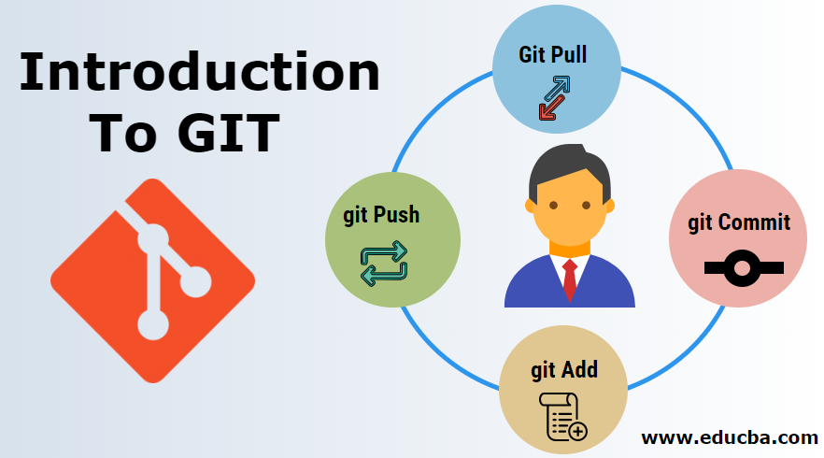
By
Megha Gupta
A version Controller

Slide 2

What is Git
Git is a popular version control system.
It was created by Linus Torvalds in 2005 and has been maintained by Junio Hamano since then.
It is used for:
Tracking code changes
Tracking who made changes
Coding collaboration

Slide 3
Why do we use git
Manage projects with Repositories
Clone a project to work on a local copy
Control and track changes with Staging and Committing
It allows working on different parts and versions of a project
Pull the latest version of the project to a local copy
Push local updates to the main project

Slide 4
Why GIT
Over 70% of developers use Git!
Developers can work together from anywhere in the world.
Developers can see the full history of the project.
Developers can revert to earlier versions of a project.
Developers can make a clone of the repository before the final commit.

Slide 5
What is GitHub
Git is not the same as GitHub.
GitHub makes tools that use Git.
GitHub is the largest host of source code in the world and has been owned by Microsoft since 2018.
Today, we will focus on using Git with GitHub.
There are other platforms:
Bitbucket
GitLab

Slide 6
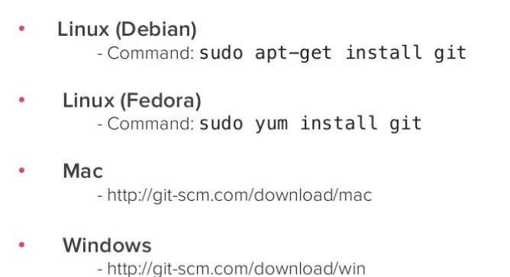
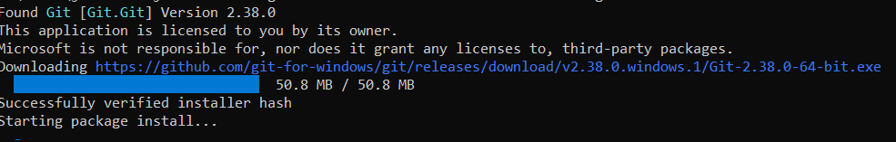
Install git
Windows
winget install --id Git.Git -e --source winget

Slide 7
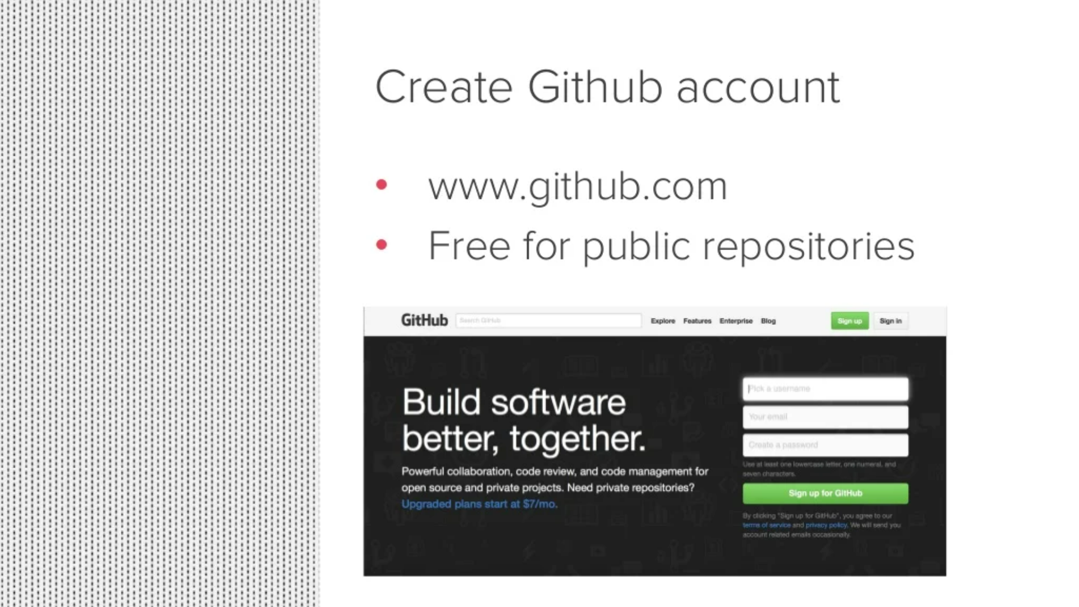
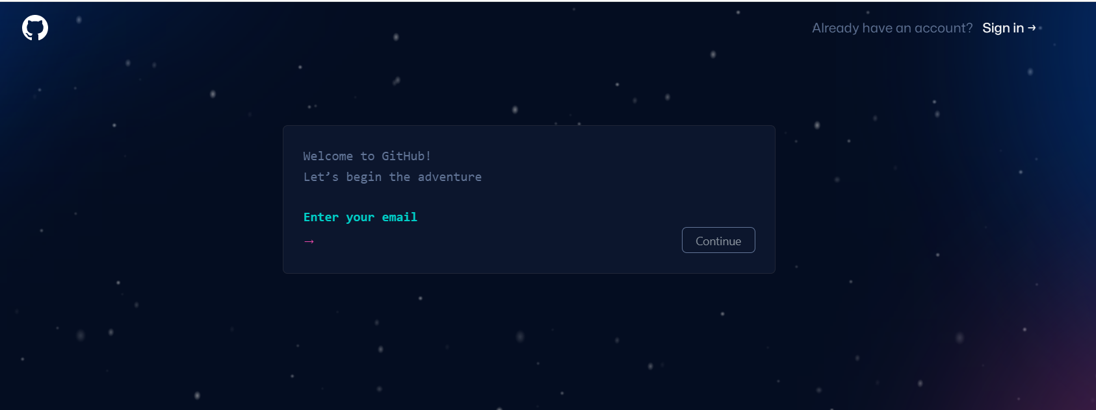
Create or Use github

Slide 8

GIT pull
The git pull command is used to fetch and download content from a remote repository and immediately update the local repository to match that content.
Merging remote upstream changes into your local repository is a common task in Git-based collaboration workflows.
git pull [Repository Link]
This command fetches and merges changes on the remote server to your working directory.

Slide 9
GIT add
The git add command adds a change in the working directory to the staging area.
It tells Git that you want to include updates to a particular file in the next commit.
git add <file/directory name>
However, git add doesn't really affect the repository in any significant way—changes are not actually recorded until you run git commit.

Slide 10
GIT commit
The git COMMIT command adds and commits files to the git repository.
git commit -m <commit message>
Note that you have to explicitly tell Git which changes you want to include in a commit before running the "git commit" command.

Slide 11
GIT push
The git push command is used to upload local repository content to a remote repository.
Pushing is how you transfer commits from your local repository to a remote repo.
It's the counterpart to git fetch, but whereas fetching imports commits to local branches, pushing exports commits to remote branches.
git push -u origin <branch_name>

Slide 12
Stablish new repositories
echo "# DemoRepo" >> README.md
git init
git add README.md
git commit -m "first commit"
git branch -M main
git remote add origin https://github.com/DemoUser/DemoRepo.git
git push -u origin main

Slide 13
push an existing repository
git remote add origin https://github.com/DemoUser/DemoRepo.git
git pull https://github.com/DemoUser/DemoRepo.git
git commit –m “my changes”
git push -u origin main

Slide 14


Thank You! For Your Attention

